Slide 1
March 21, 2023
Mauricio E. Tano & Vasileios Kyriakopoulos
Computational Scientists
Validation of Pronghorn’s Subchannel code with EBR-II
shutdown heat removal tests.

Slide 2
Outline
Motivation
Benchmark Description
Subchannel Results

Slide 3
Motivation

Slide 4
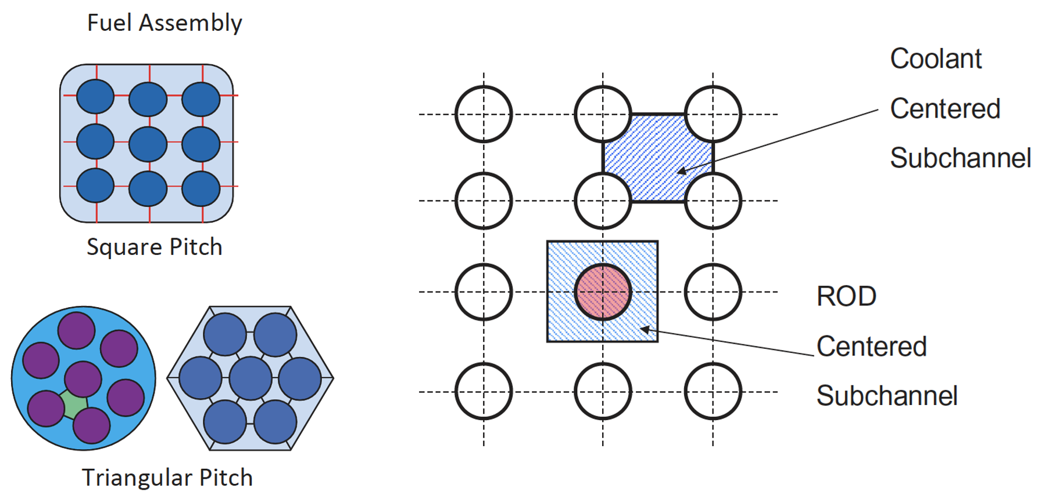
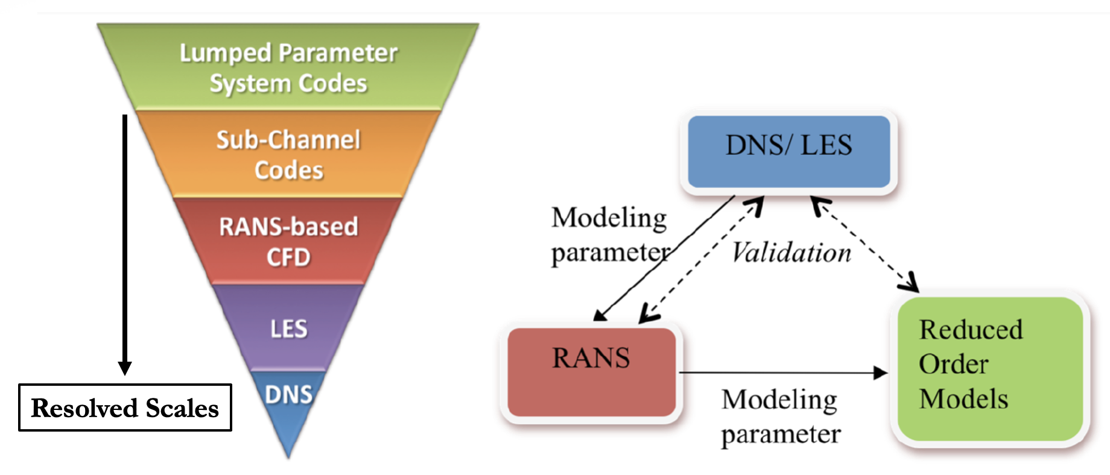
Overview
The system level thermal hydraulic analysis codes like RELAP, RETRAN, ATHLET are used to get the balance of plant behavior.
The results of this analysis give the boundary conditions used for the core level/component analysis.
The detailed analysis of the reactor core is performed using the sub-channel thermal hydraulic codes.
A sub-channel is defined as the ideal flow passage formed between number a of rods or some rods and wall of channel/shroud tube
Subchannel codes are thermal-hydraulic codes that offer an efficient compromise for the simulation of a nuclear reactor core, between CFD and system codes

Slide 5
Context
Pronghorn is an engineering-scale, coarse-mesh, thermal-hydraulics tool for supporting reactor-core simulations of advanced nuclear reactors
Most of the current efforts in Pronghorn have been devoted to developing porous finite-volume capabilities and adapted closure correlations for coarse-mesh thermal-hydraulics modeling
However, for liquid-metal reactors (LMRs) involving wire-wrapped fuel assemblies, pin-level thermal hydraulic resolution is required for most safety cases (pin rupture, channel blockage, etc.)
For this purpose, a new subchannel solver is developed in MOOSE, which allows us to solve the inter-pin flow field while still preserving an engineering-scale approach
This new solver can be natively coupled to Pronghorn and other MOOSE objects to enable full-core, multiphysics, multi-fidelity engineering studies

Slide 6
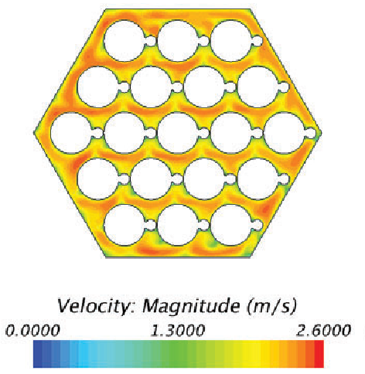
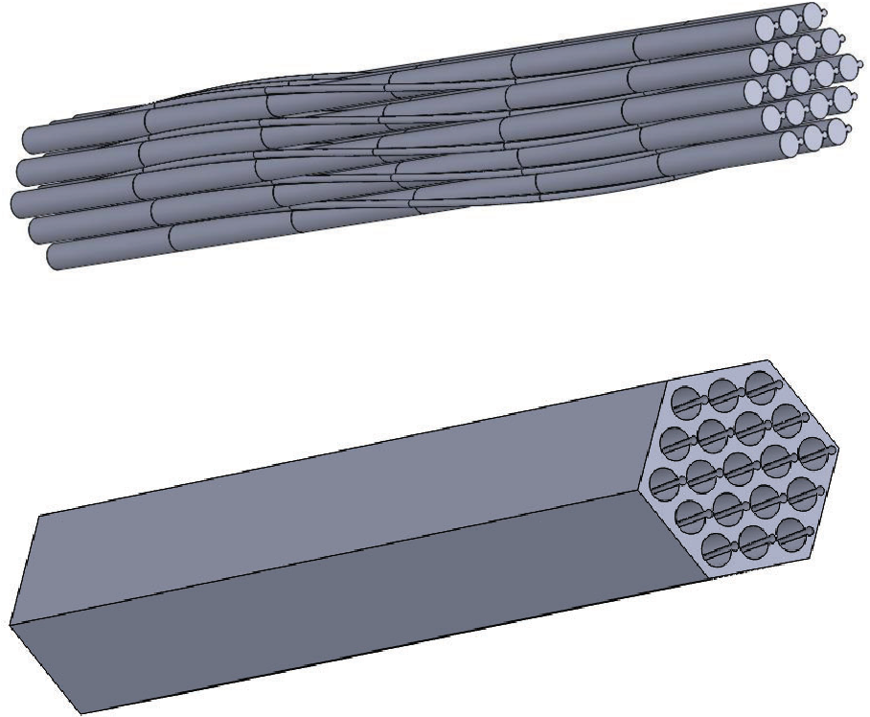
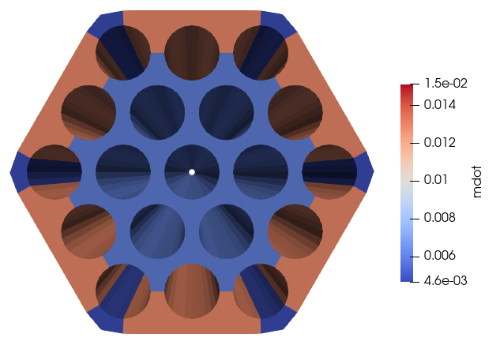
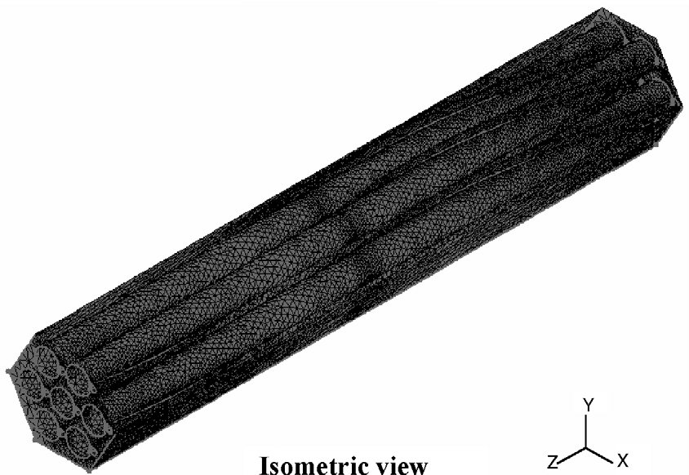
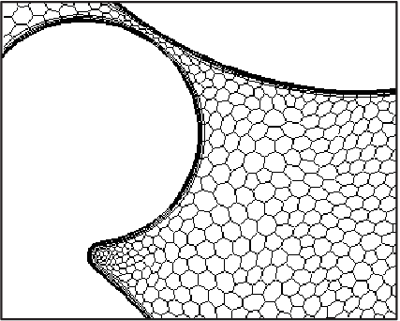
Principles of subchannel formulation
Wire-wrapped fuel assembly
CFD simulation
Subchannel model
Resolves:
Mass, momentum (axial and cross directions), and energy balance
Requires:
Closure correlations for friction factors, localized pressure losses, and heat exchange coefficients

Slide 7
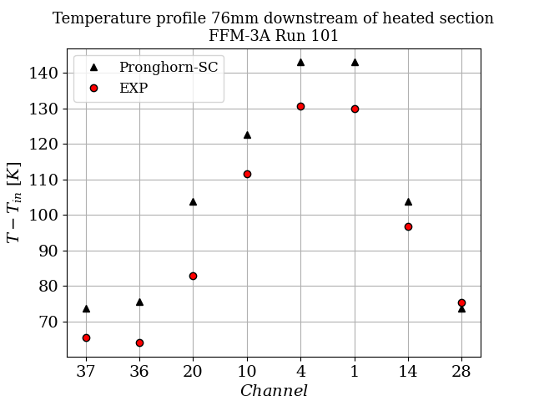
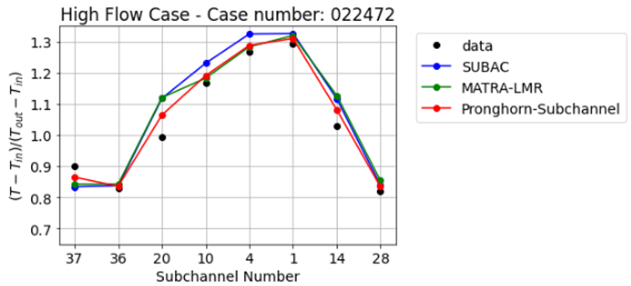
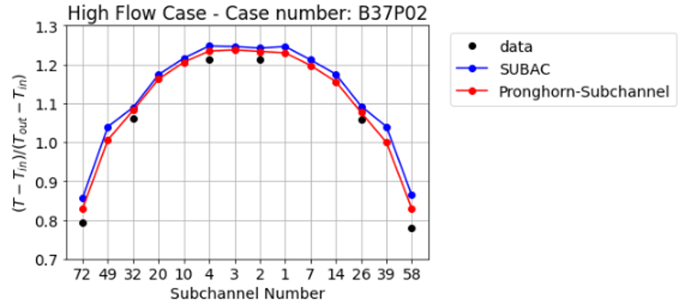
Expansion of Pronghorn’s Subchannel code to Sodium Fast Reactors
Subchannel Code Resolves:
Mass, momentum (axial and cross directions), and energy balance
Requires:
Closure correlations for friction factors, localized pressure losses, and heat exchange coefficients
Wire-wrapped fuel assembly
CFD model
Subchannel model
Validation
THORS blockage benchmark
ORNL 19-pin benchmark
Toshiba 37-pin benchmark

Slide 8
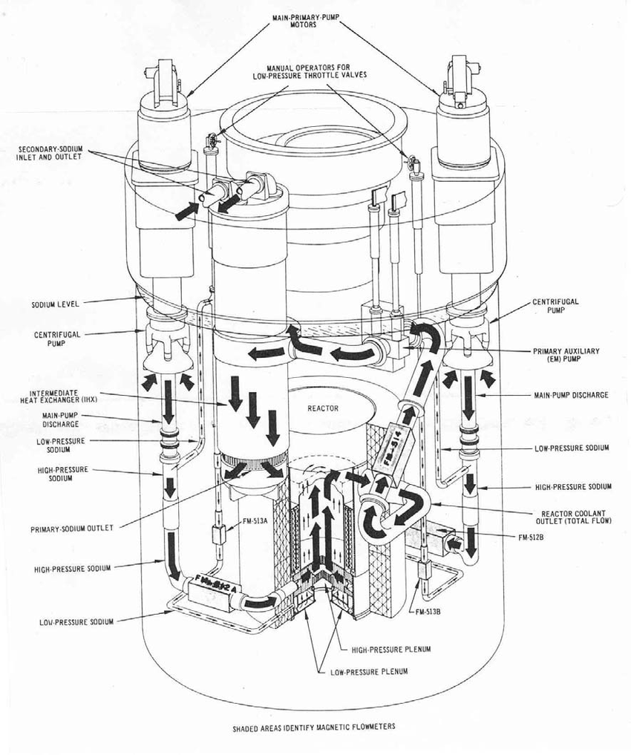
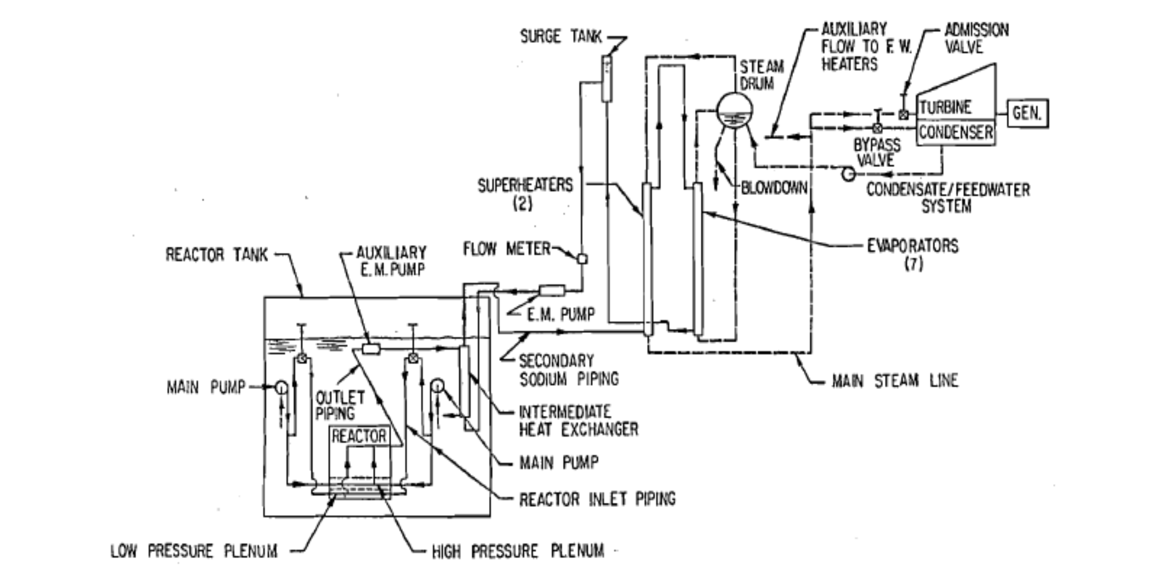
EBR-II
EBR-II Plant Schematic
Reactor/Subassembly Geometry and Boundary conditions

Slide 9
Test Description

Slide 10
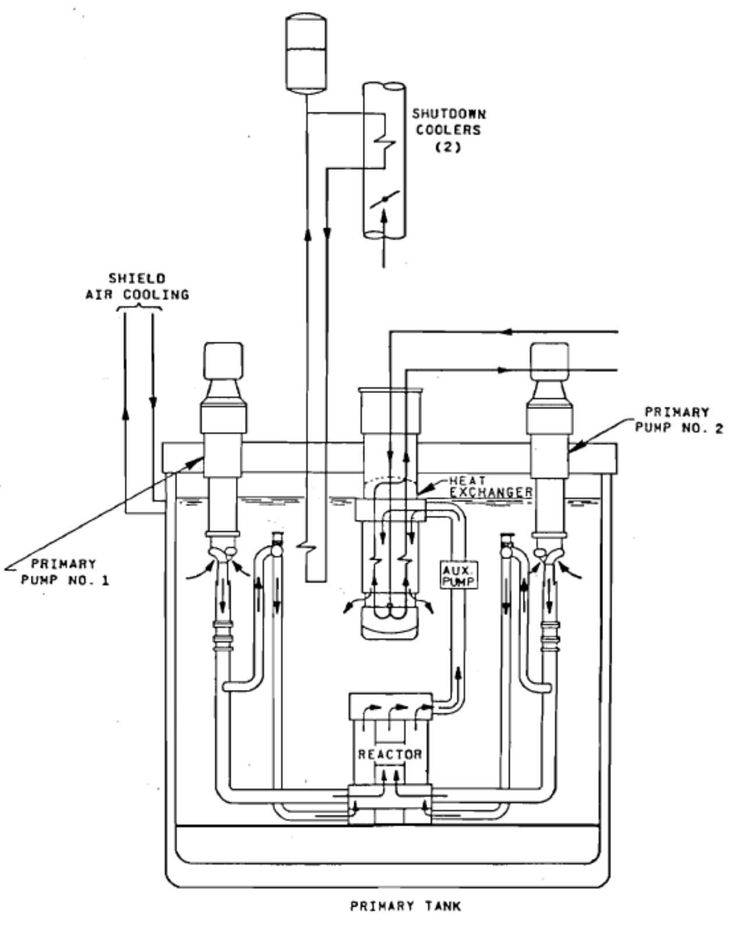
SHRT-17, SHRT-45R Tests
EBR-II Primary Tank Sodium Flow Paths
The Shutdown Heat Removal Test (SHRT) program was carried out in EBR-II between 1984 and 1986.
On June 20, 1984, the SHRT-17 loss of flow test, was conducted where a loss of electrical power to all the plant sodium coolant pumps was used to demonstrate the effectiveness of natural circulation cooling characteristics.
Starting from full power and flow, both the primary and intermediate-loop coolant pumps were simultaneously tripped and the reactor was scrammed to simulate a protected loss-of-flow accident.
Temperatures in the reactor quickly rose to high, but acceptable levels as the natural circulation characteristics cooled the reactor down safely at decay heat levels.
Similarly to SHRT-17, the SHRT-45R test was initiated by a trip of the primary and intermediate pumps under the rated-power condition at 60.0 MW, but without scram.

Slide 11
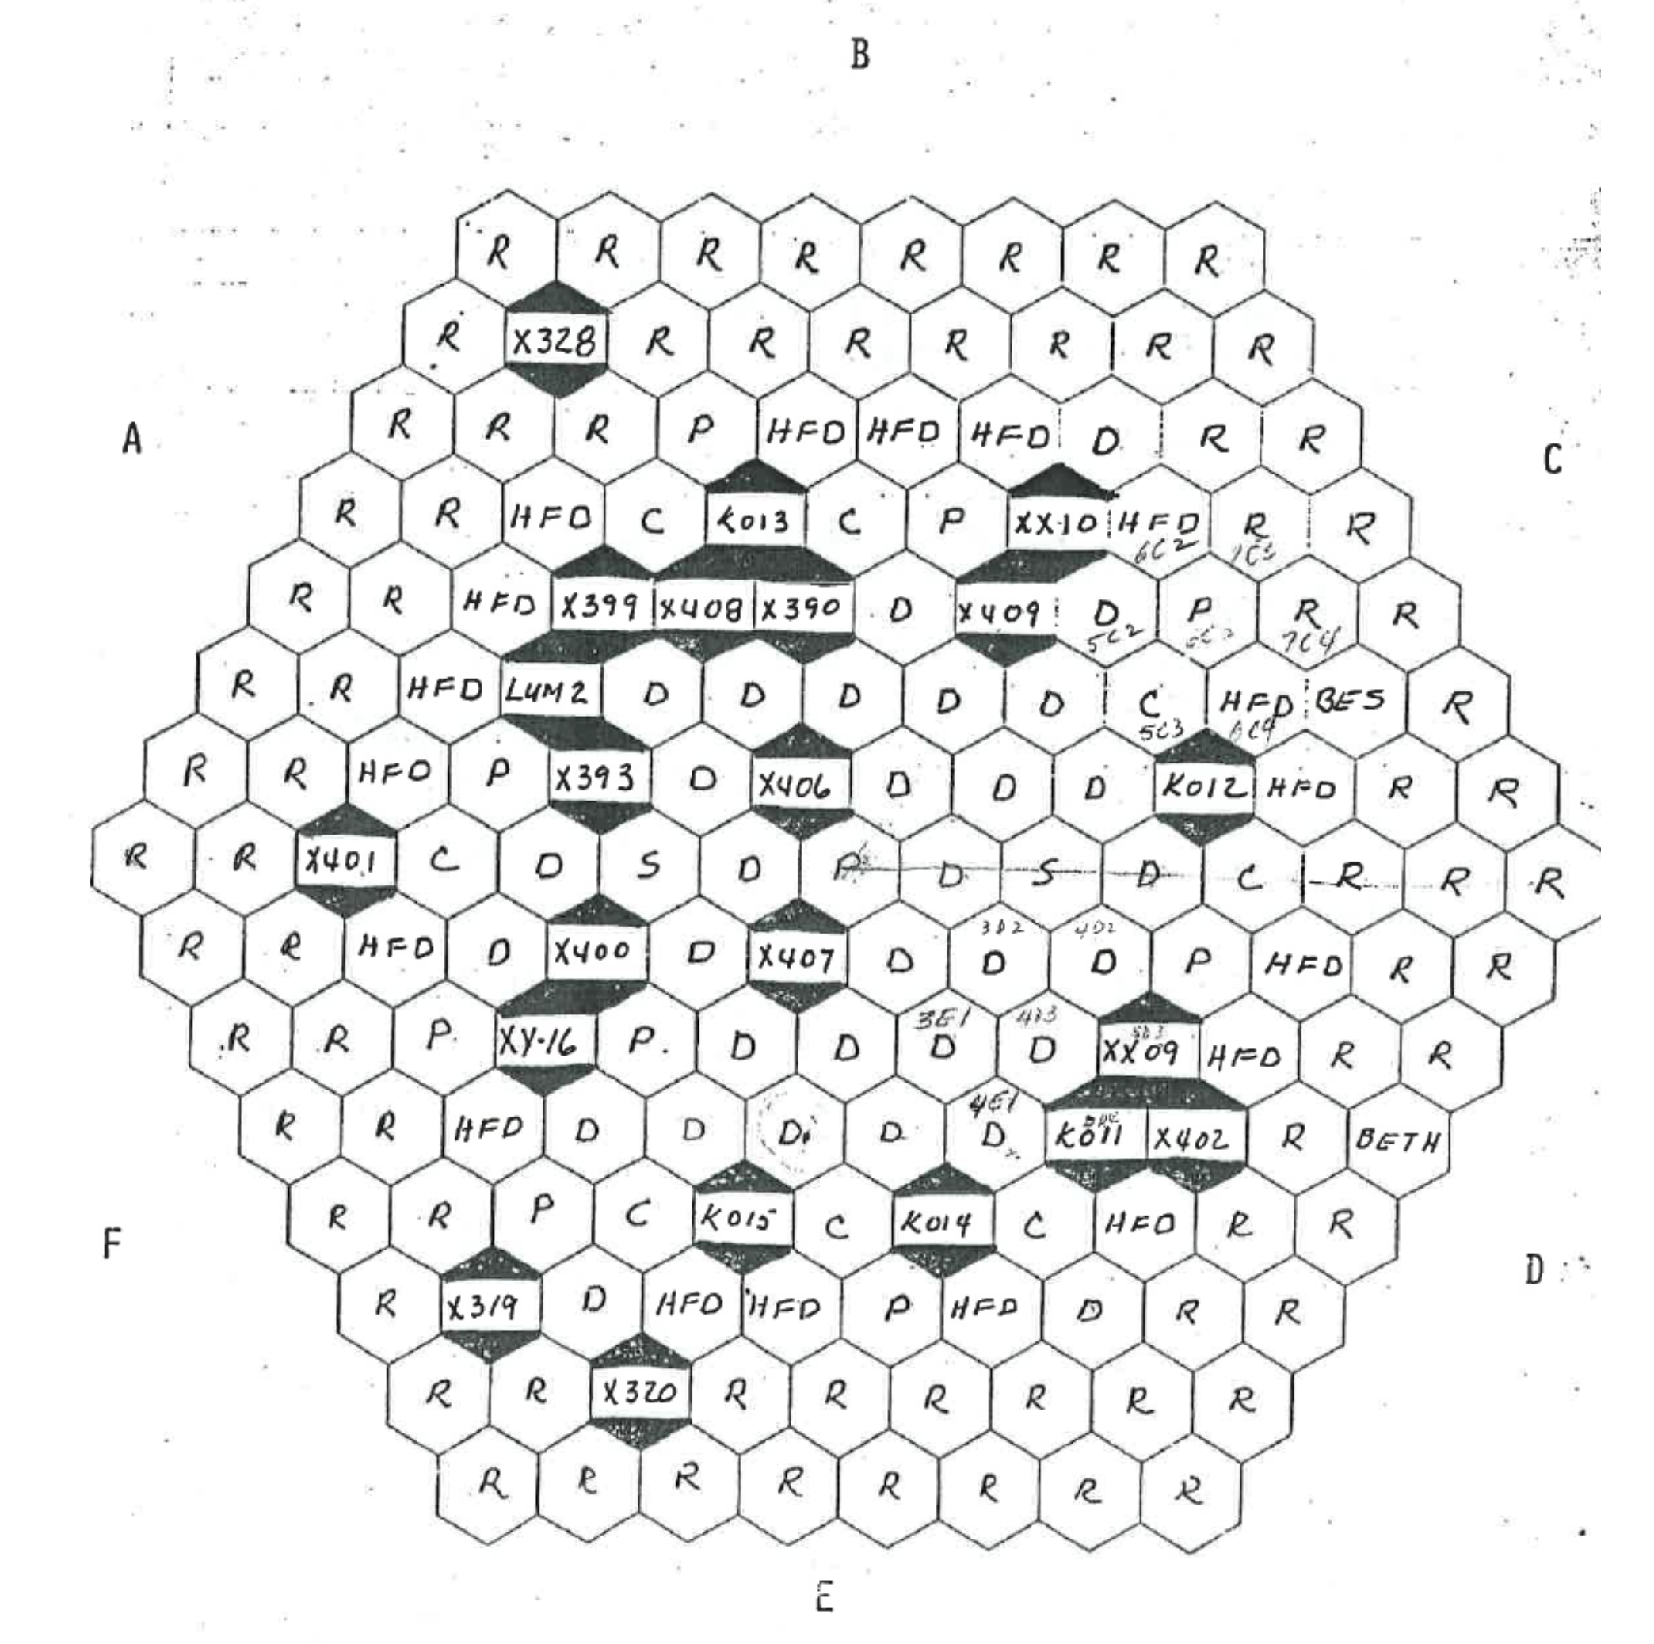
Instrumented Subassemblies (XX09 & XX10)
There are two instrumented subassemblies in the reactor core, which are labeled as XX09 and XX10.
The XX09 is a kind of driver subassembly loaded in the 5th row (4th ring) and the XX10 is a specific subassembly of which fuel pins are replaced by stainless steel pins.
the XX09 subassembly contains 61 pins wound by wire spacers. Diameters of the cladding and wire are 4.419 mm and 1.244 mm, respectively. Two out of the 61 pins contain flow meters instead of fuel slugs.
SHRT-17 Core Loading Pattern (First 8 Rows)

Slide 12
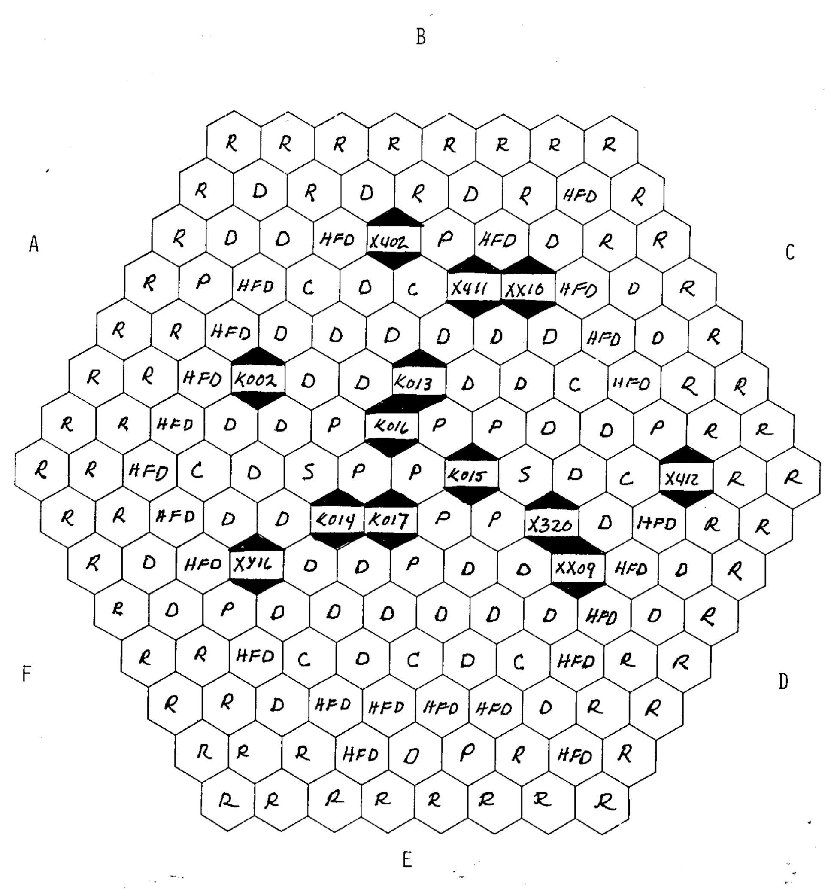
Instrumented Subassemblies Layout (XX09 & XX10)
SHRT-45R Core Loading Pattern (First 8 Rows)
SHRT-17 Core Loading Pattern (First 8 Rows)

Slide 13
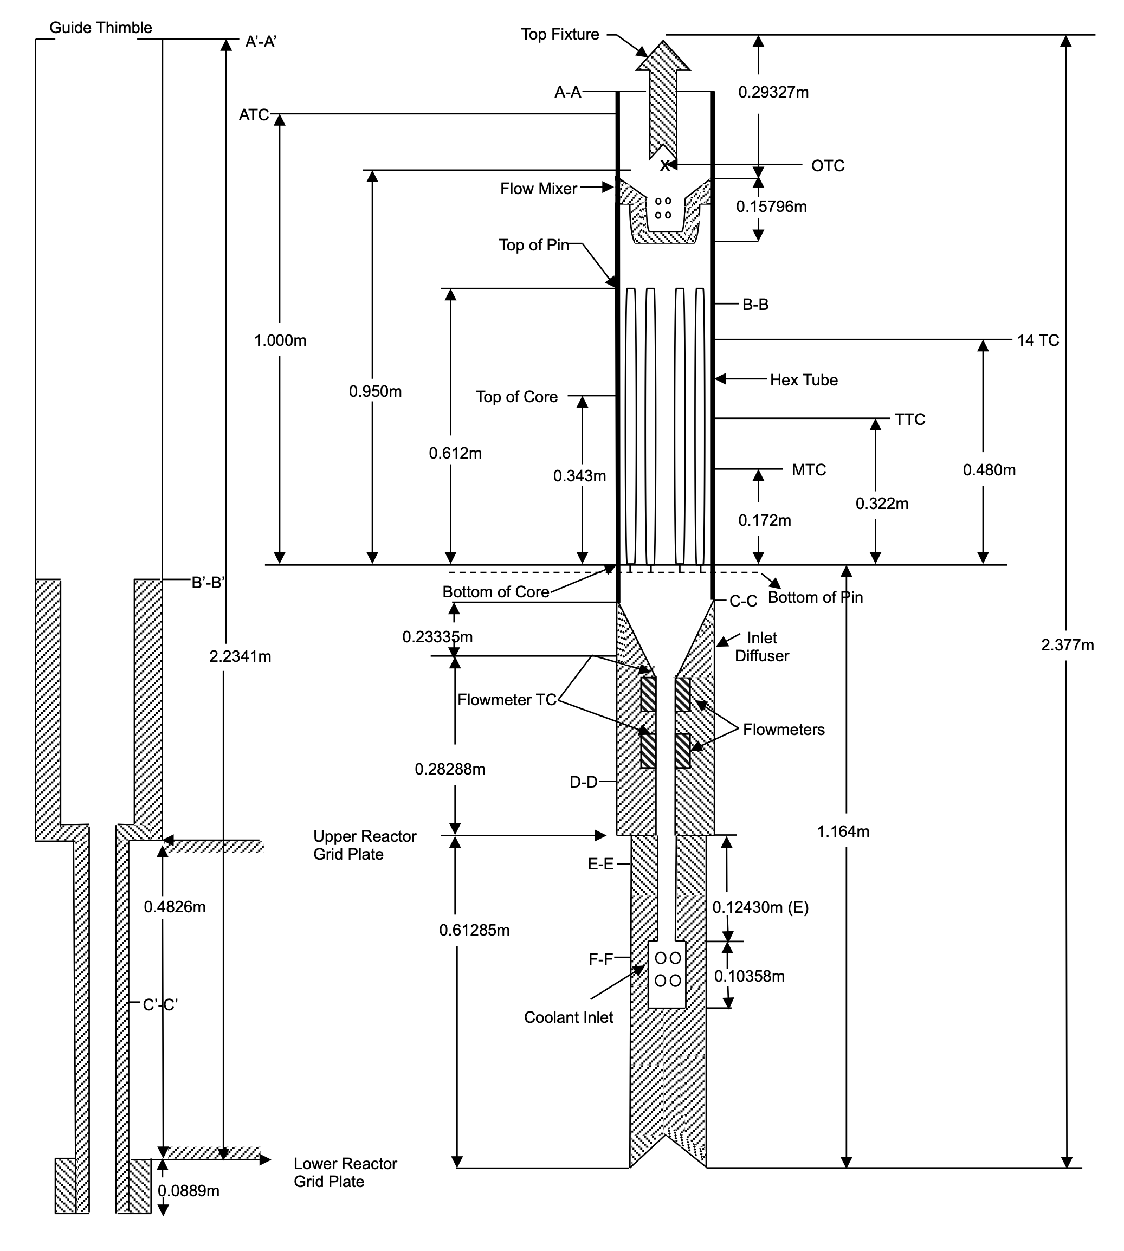
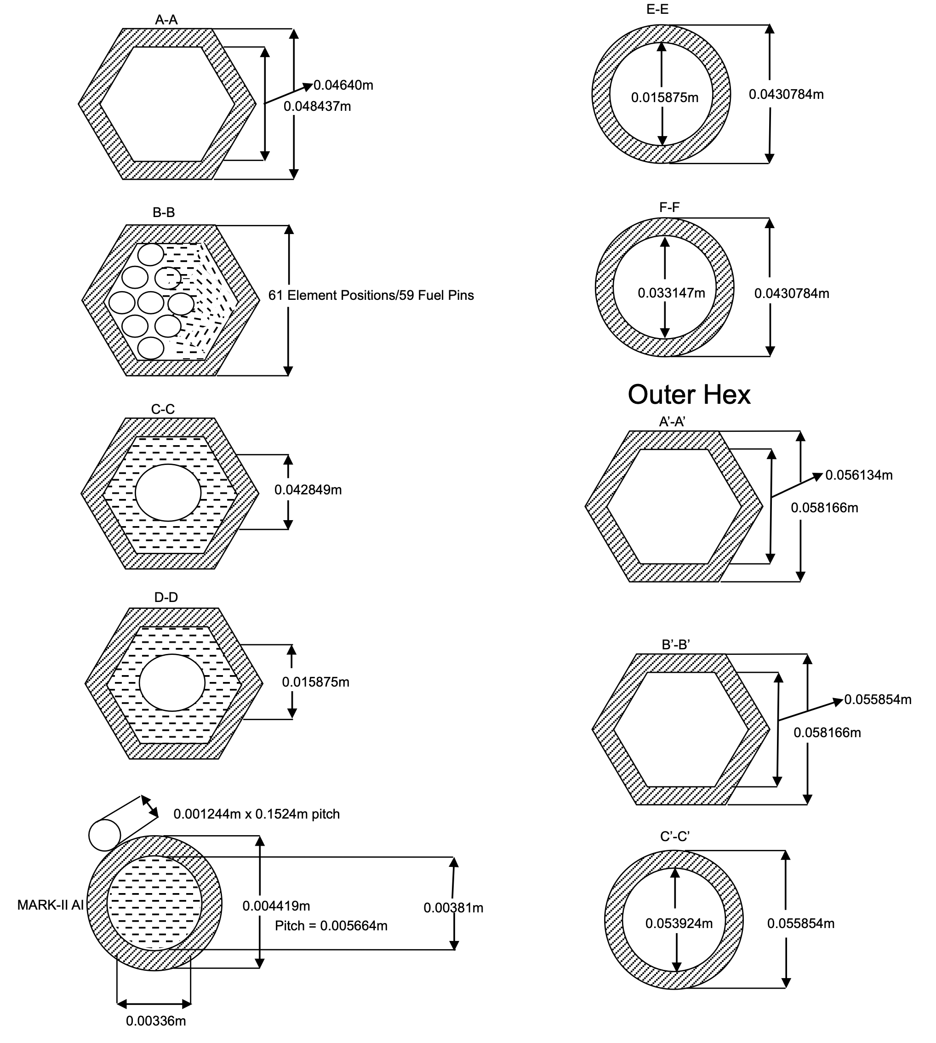
Instrumented Subassembly XX09

Slide 14
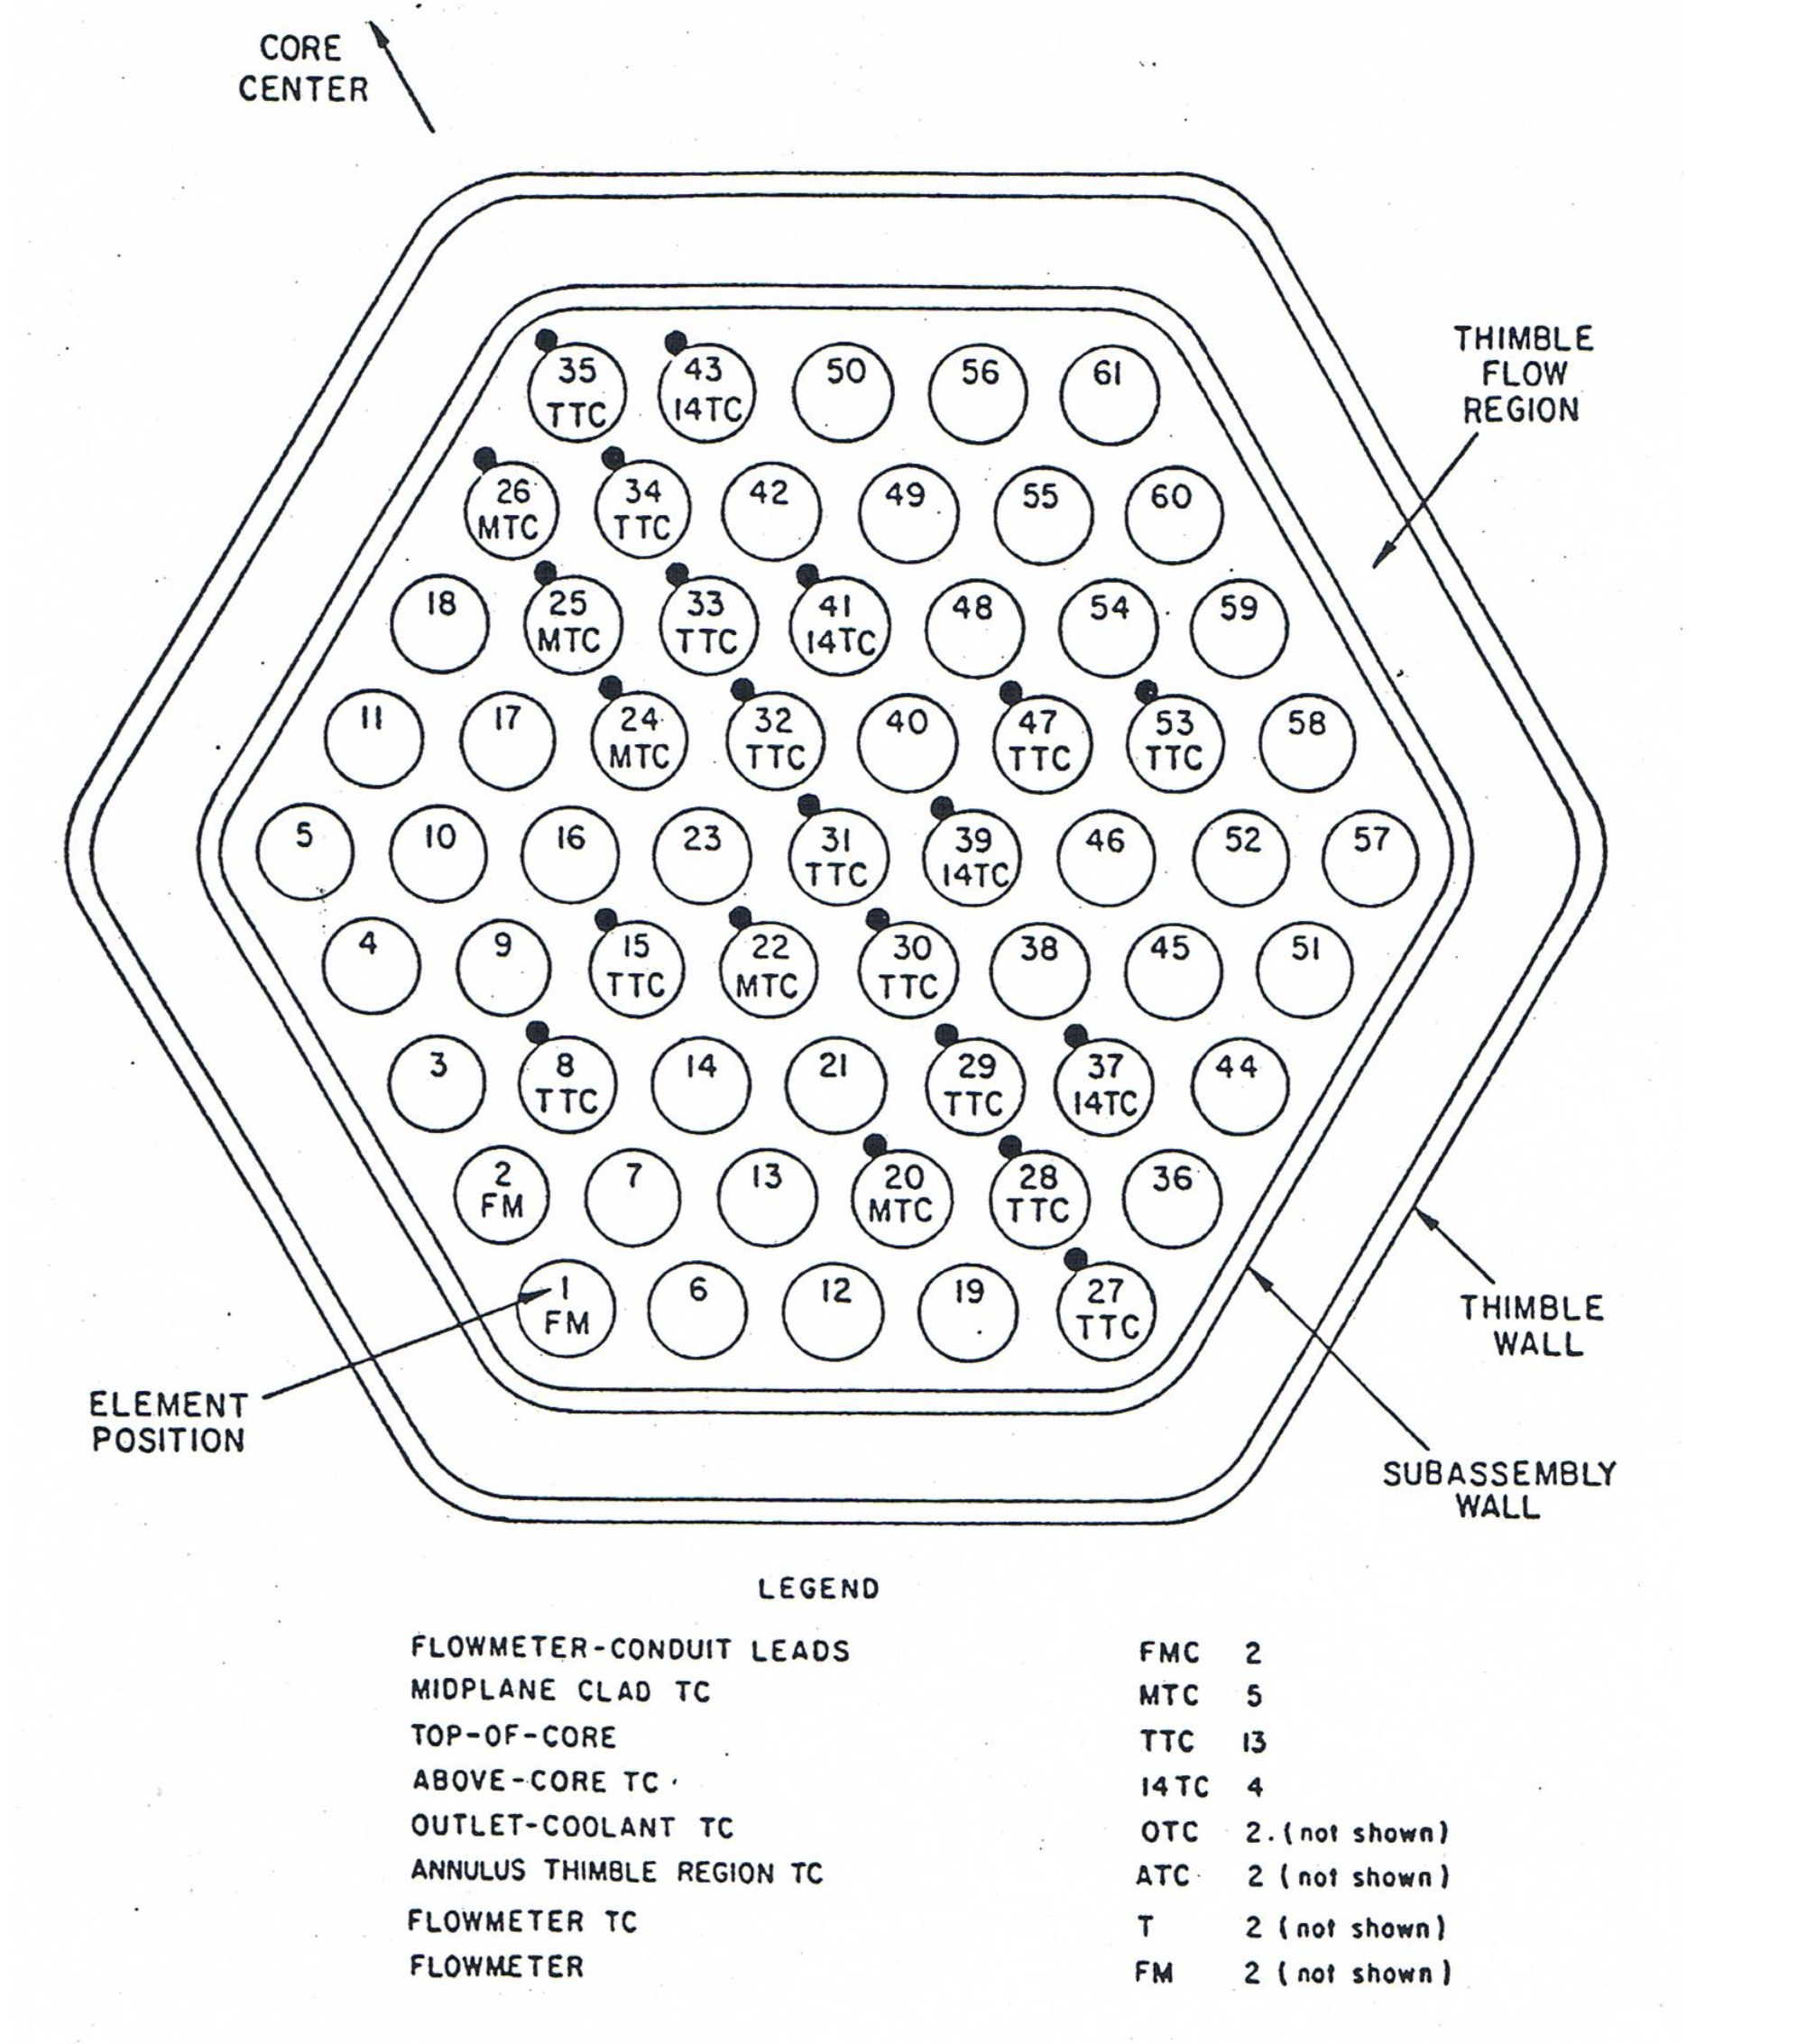
Instrumented Subassembly XX09
XX09 Instrumented subassembly instrument loading

Slide 15
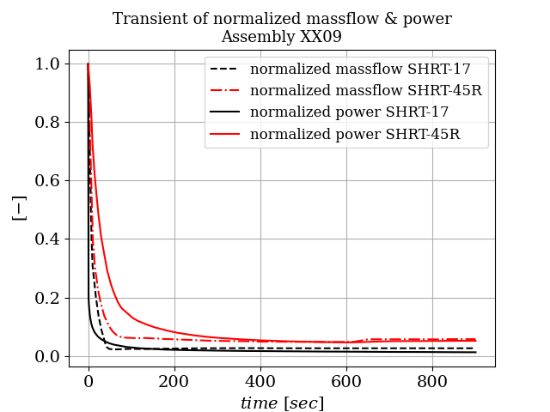
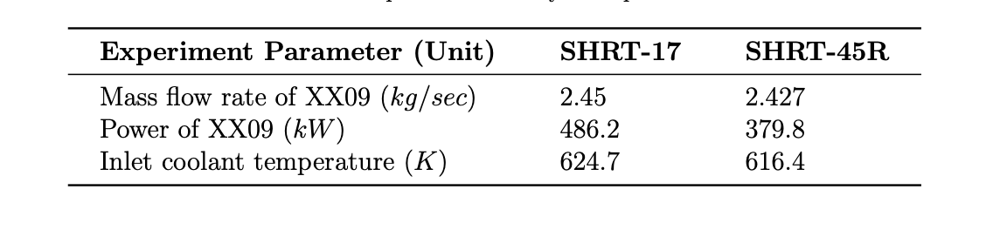
Boundary Conditions

Slide 16
Subchannel Results

Slide 17
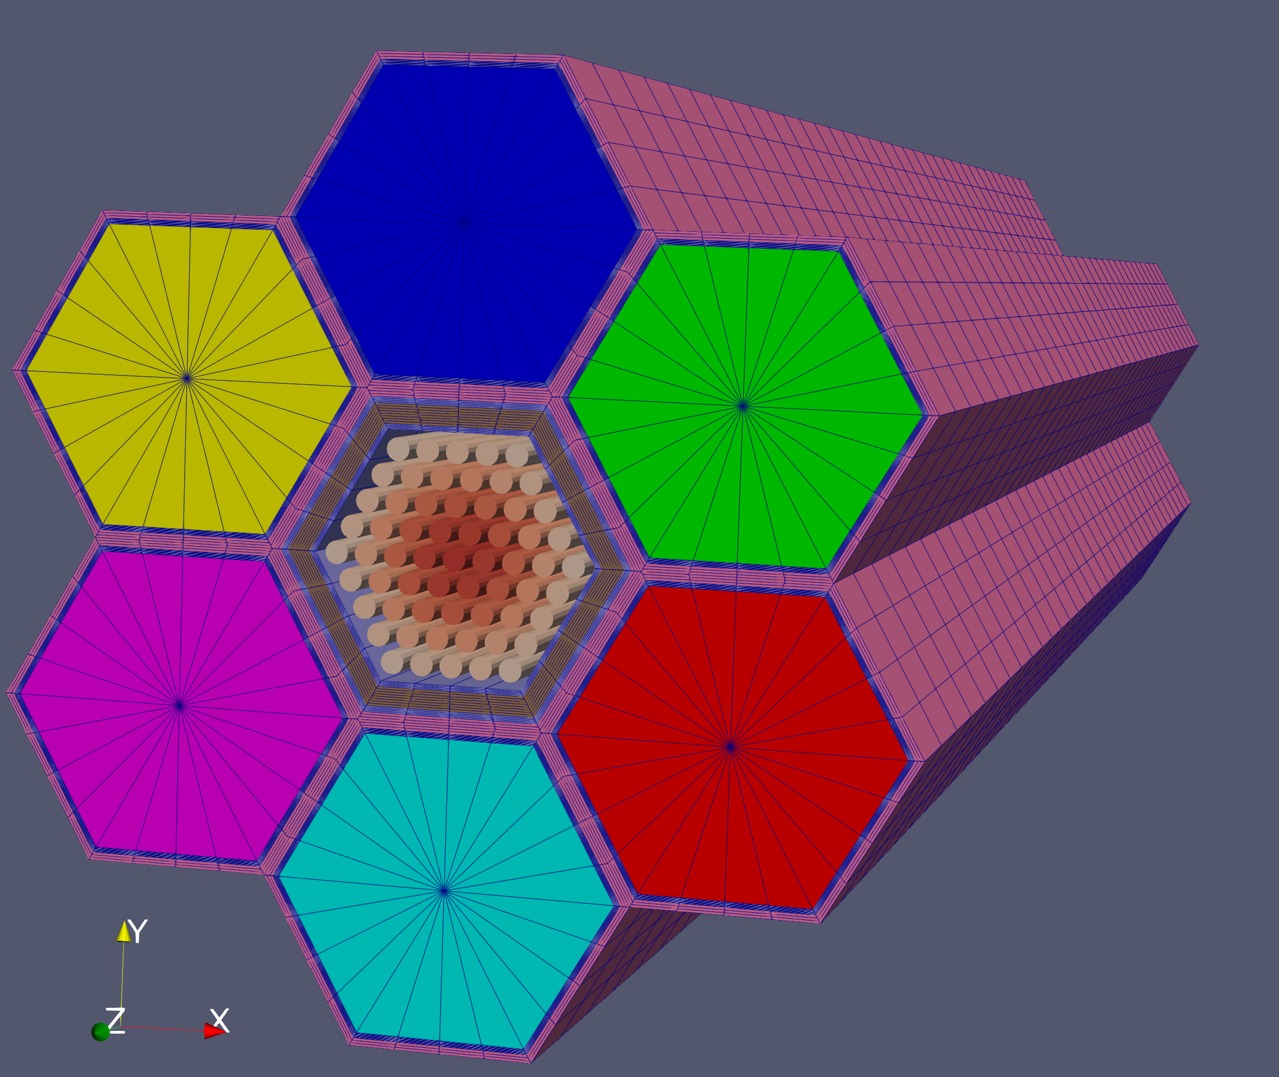
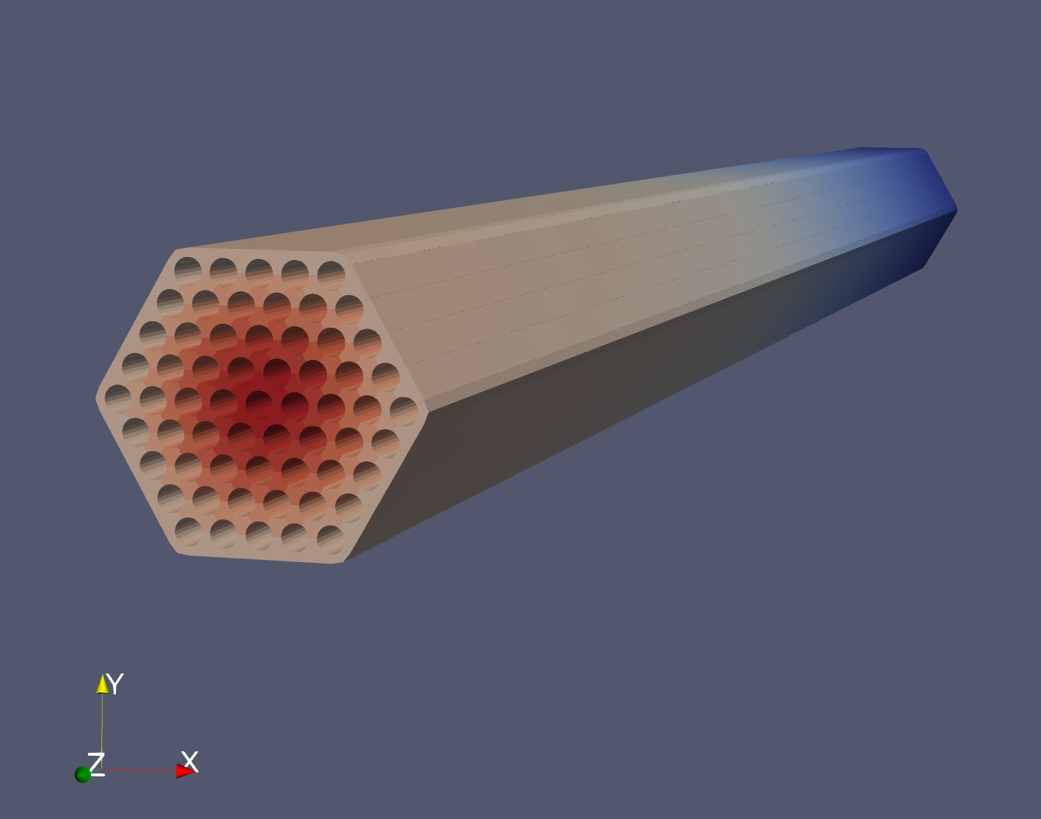
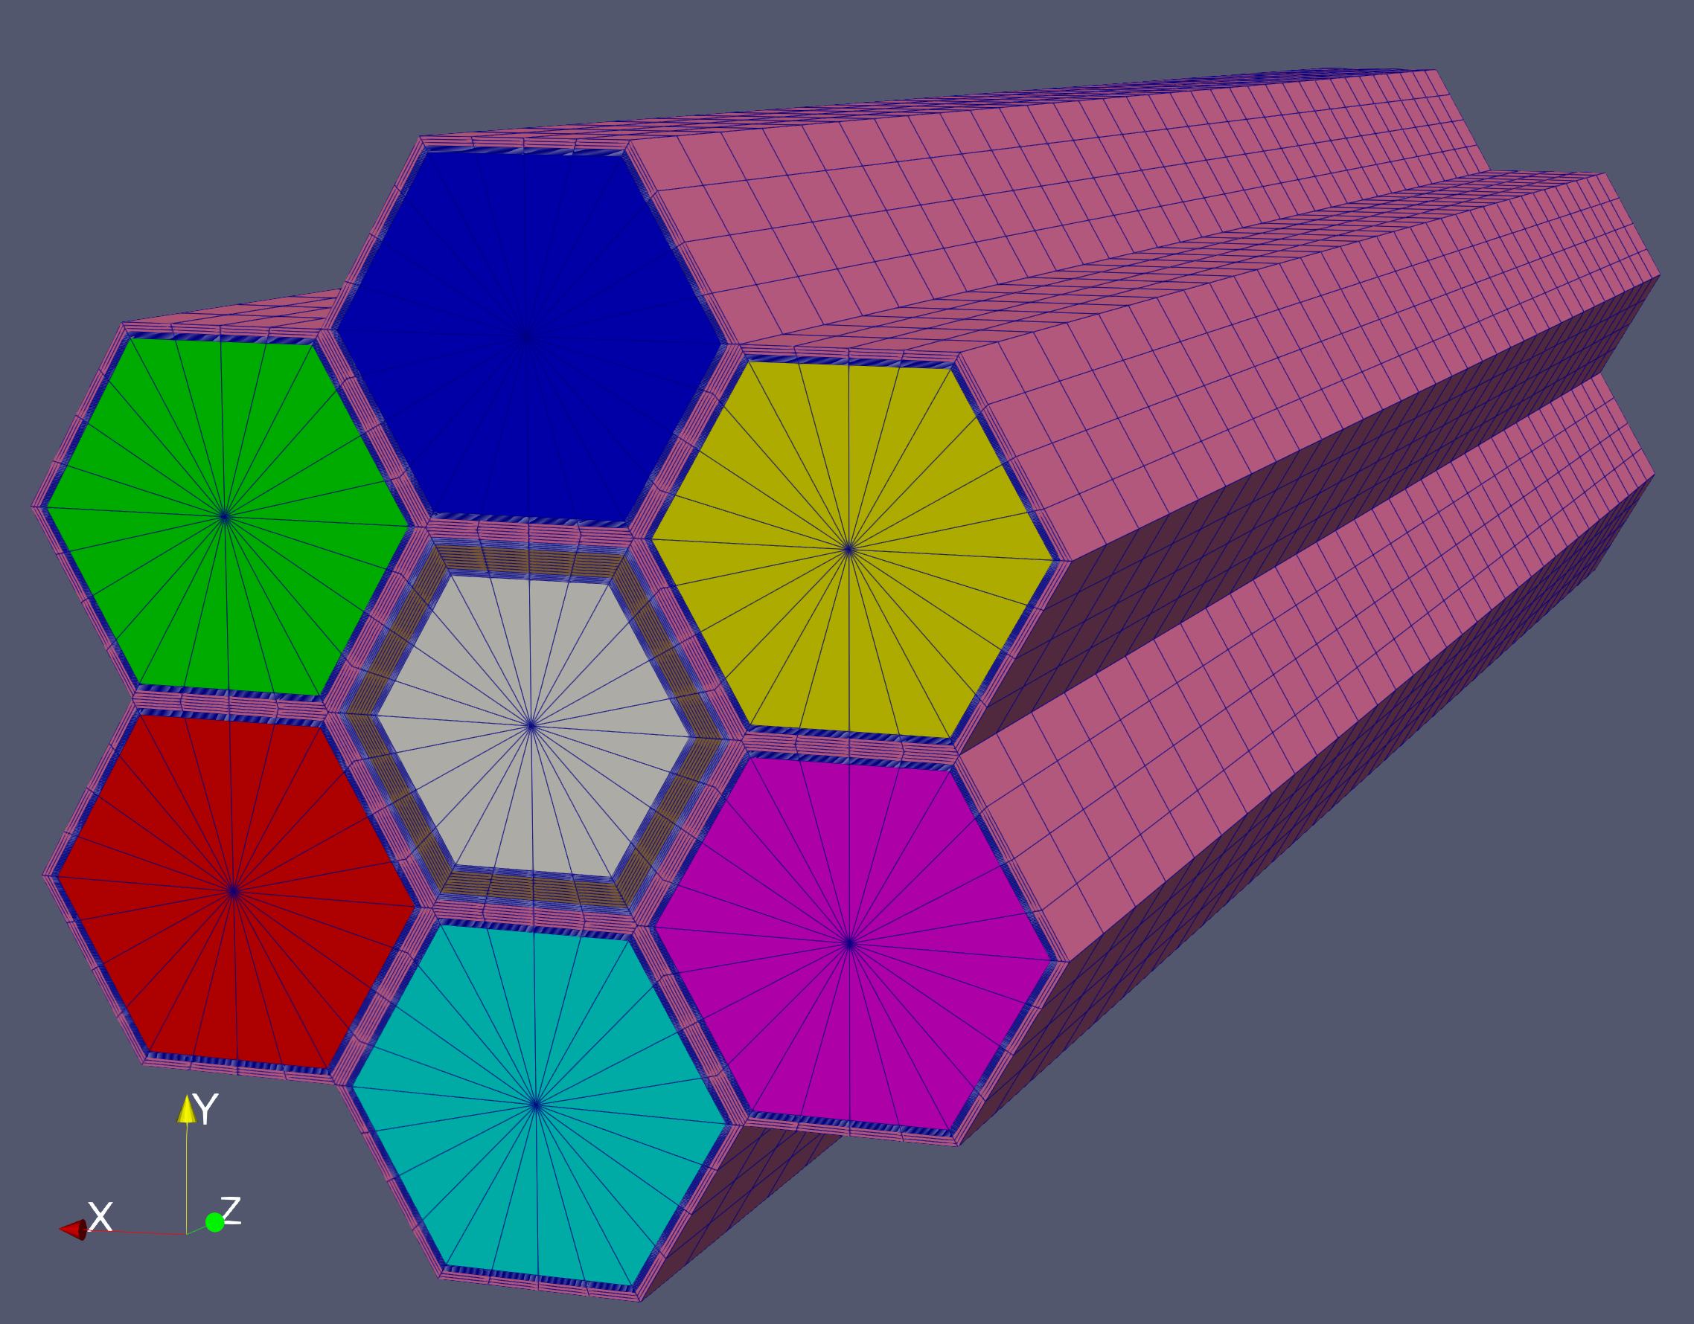
Models of XX09
Subchannel
Domain-Overlapping
Pronghorn

Slide 18
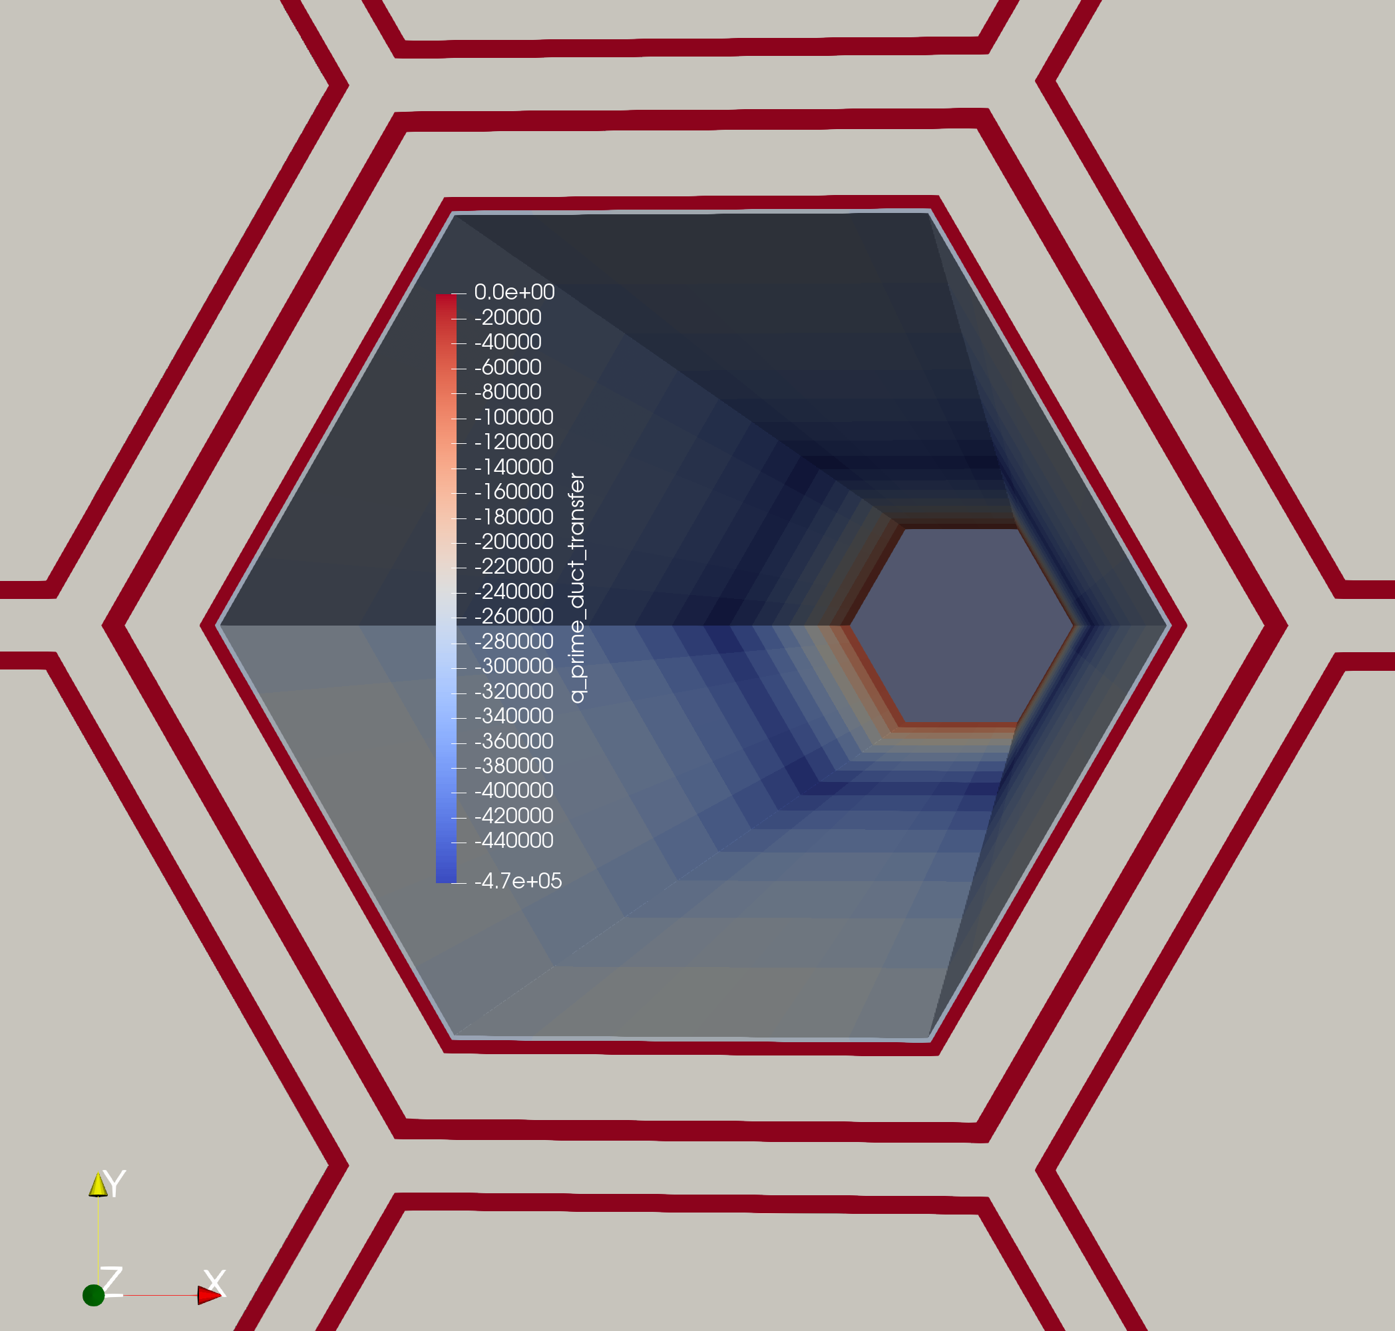
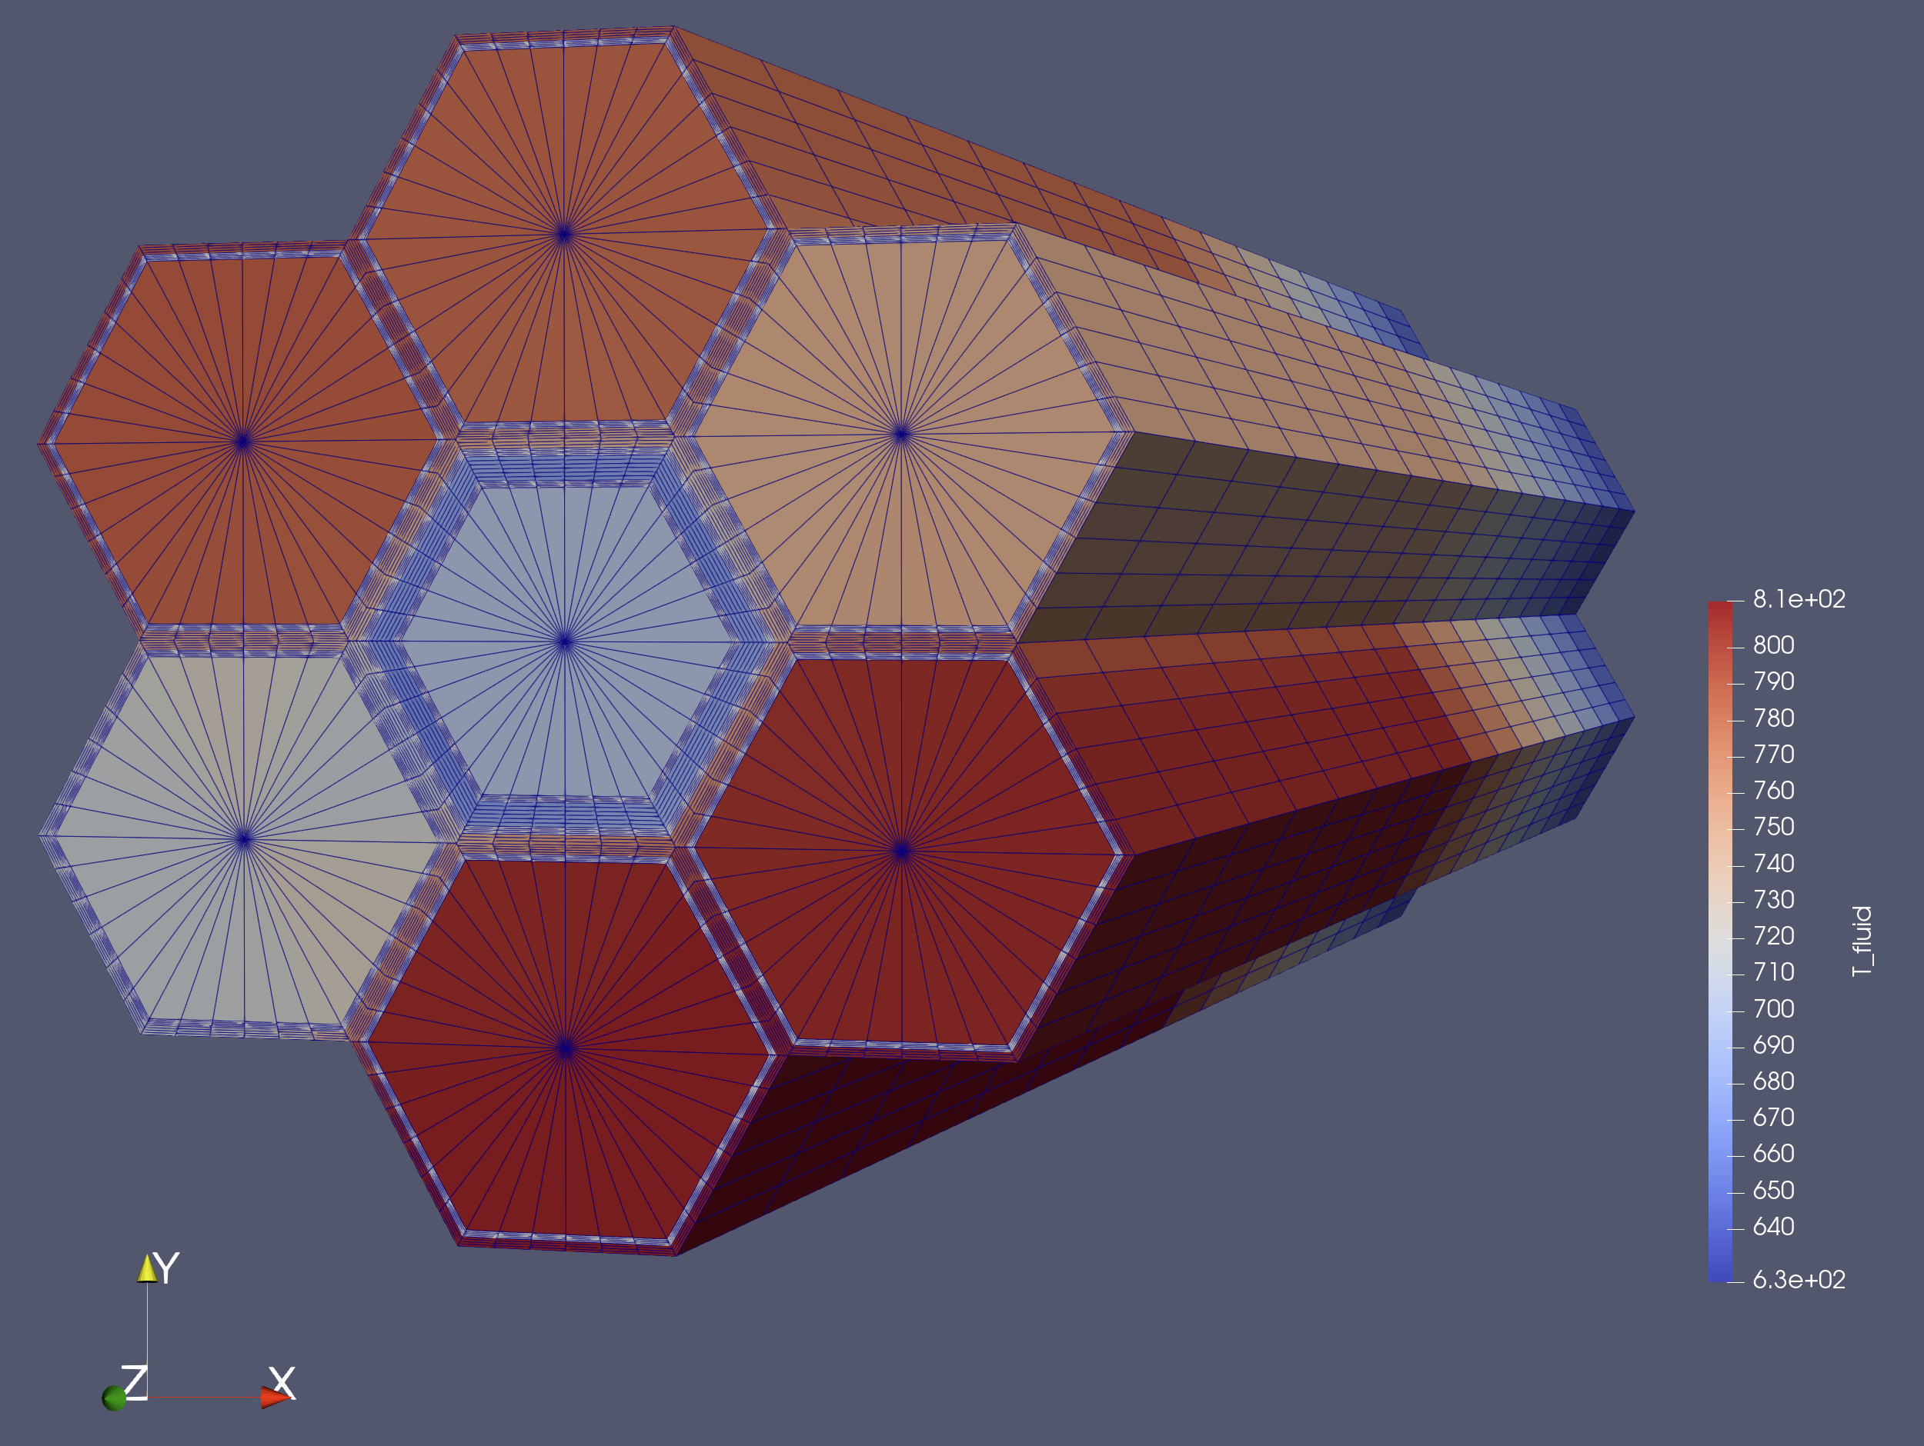
Pronghorn solution, steady state SHRT-17
Fluid temperature field
Linear heat flux on Pronghorn/Subchannel interface

Slide 19
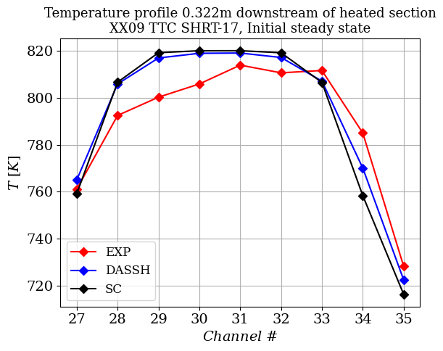
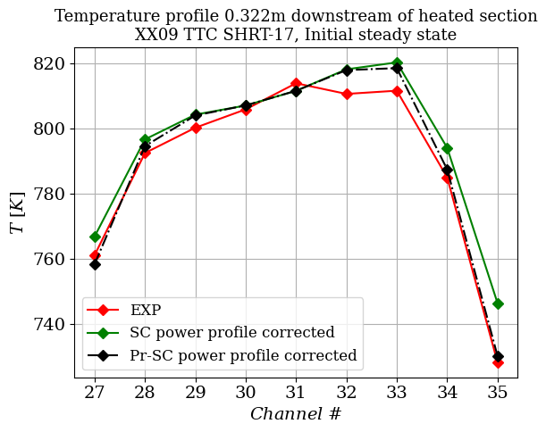
Results of Subchannel Initial Steady State for XX09 SHRT-17

Slide 20
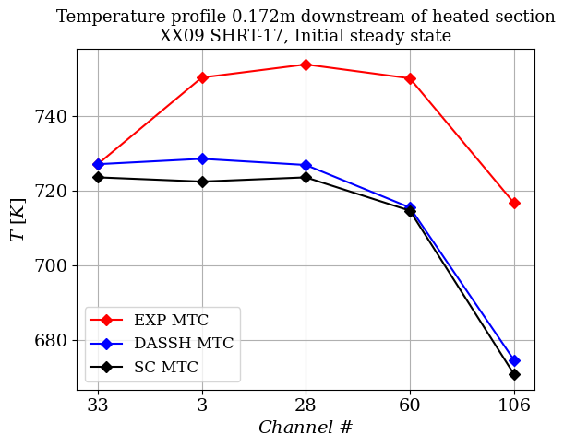
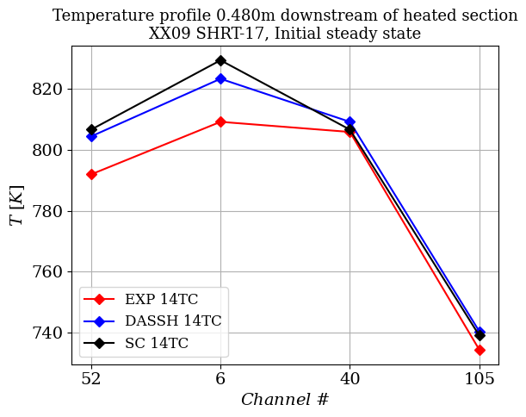
Results of Subchannel Initial Steady State for XX09 SHRT-17

Slide 21
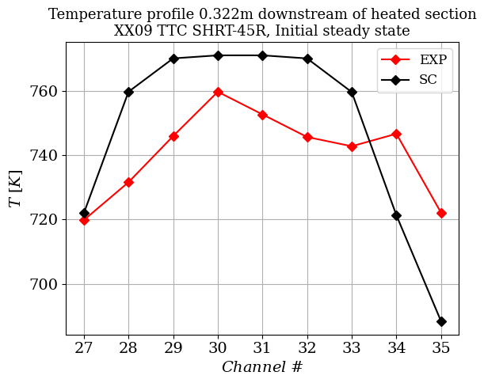
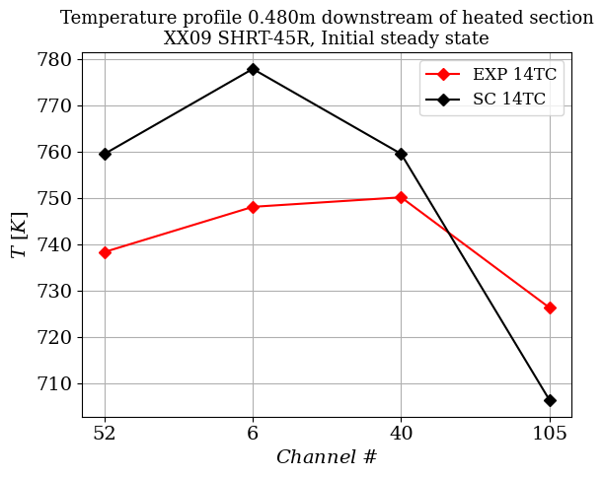
Results of Subchannel Initial Steady State for XX09 SHRT-45R

Slide 22
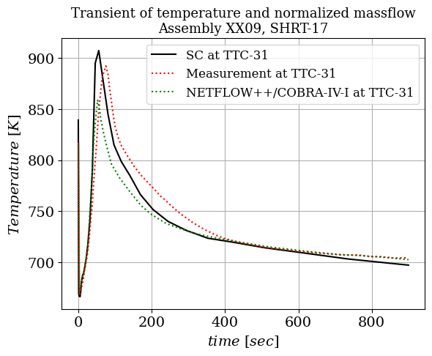
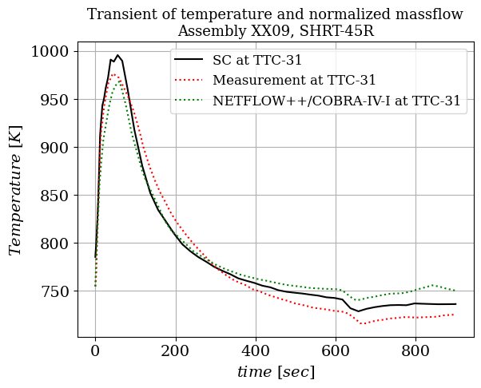
Results of Subchannel Transient for XX09
Mochizuki, H., & Muranaka, K. (2018). Benchmark analyses for EBR-II shutdown heat removal tests SHRT-17 and SHRT-45R–(1,2) subchannel analysis of instrumented fuel subassembly. Nuclear Engineering and Design, 330, 14-27.

